Slide 1



ESF Transnational project
Service User Involvement from Education to
Labour market (SIEL)

Slide 2
Overview
Transnational ESF project
  Background
  To a Transnational research project
    Research questions
    Methodology
    Objectives
Models developed by the project partners
  Belgium: Working in tandem in a course: Bind-Kracht at the Karel de Grote University college
  Sweden:
      Service Users as students in the Mobilisation course of Lund University
      Service Users as peer-researchers
Search for inspiring practices

Slide 3
Transnational ESF-project

Slide 4
Background
Service user involvement and participation in higher education = increasingly popular methodology
Today: variable practices -> different social work schools in different countries hold different views
Also: diversity of service users: poverty, migration, homelessness, youth care, drugs and mental health problems.
Common challenge: no systematic implementation of service-user involvement in higher education
Therefore: need for a inspiring book (covering themes including basic principles, practicalities, legal and organisational conditions for the participation of service users

Slide 5
To a transnational ESF project
  Research questions:
    Which tasks/responsibilities can be taken up by service users?
    Which statutes are possible (job description, competency profile, payment)?
    What are the organisational conditions/ framework necessary to guarantee a high-quality collaboration?
Methodology:
description and thematic analysis of inspiring models of service user involvement in social work education and research

Slide 6
  Objectives: developing a structural base/anchoring of service-user involvement in social work education and research
Book with inspiring models of cooperation with service users in education and research
Articles in regional (and international) journals of social work
National conferences with stakeholders for the presentation of good practices and their outcomes
Presentations at international conferences of Social Work
Policy recommendations concerning the structural integration of service users in education/welfare organisations

Slide 7
Models developed by the project partners

Slide 8



Core research group – financed by ESF
1. Belgium (Flanders)
- Karel de Grote University College – Department of Social Work (Centre of Expertise Strengths Based Social Work
  - Bind-Kracht “Strength of Ties”
2. Sweden (Lund)
- Social Work – University of Lund – Mobilisation Course (Partner of PowerUs)
3. A Dutch partner? University College Amsterdam or UC Utrecht?

Slide 9
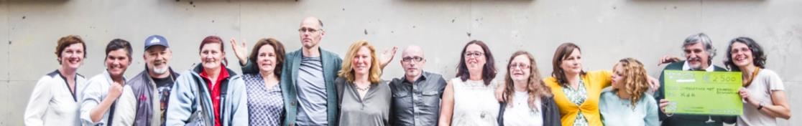
Case: Experts by experience as partners in a social work course - Antwerp (KdG)
Innovative project
Partnership: Educations of social work, socio-educational Care Work and ‘Strength of Ties’
Cooperation with experts by experience (people in poverty/service users)
Partners in a whole course
  Training course: communication in social work
  Integral course: ‘family centred work’ in child care
Participated: 22 lecturers, 13 experts by experience, 1300 students (over 4 academic years).

Slide 10
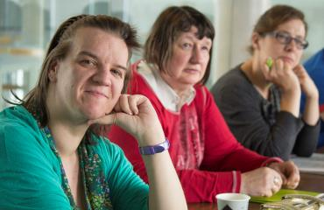
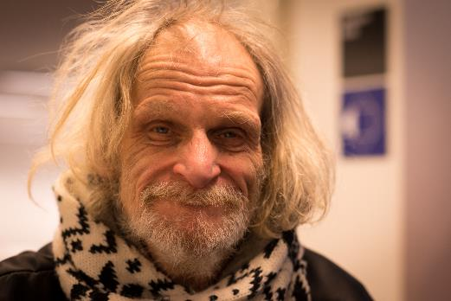
Specificity of the courses
Focus on perspective of service users and relationship with people in poverty
Broaden perceptions through conversation
Participatory and empowering approach
Working on competences: knowledge, skills and attitudes
Role of coach (expert by experience/service user)
In tandem with trainer
Bring in personal experiences and expectations
Introduce own view in case discussions

Slide 13
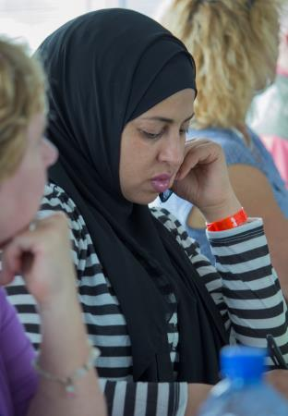
Quotes from students
“Reality enters the classroom.”
“You obtain a better understanding of what it means to live in poverty and the consequences of exclusion.”
“Theoretical frameworks brought to life through captivating real-life stories.”
“Experts by experience reflect and confront. They reveal their desire for involvement, input and participation in the delivery of services, expressing their frustrations when they are not given those opportunities.”
“This different way of looking at what you take for granted as a student was captivating.”

Slide 14
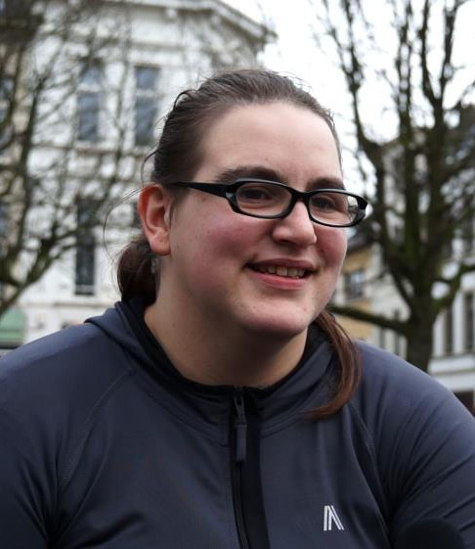
An expert by experience shares her experiences
Own goals and added value to the students
Cooperation with the lecturer/professor
Cooperation with the students

Slide 15
A lecturer and an expert by experience tell about their cooperation
Training course ‘counseling/communication techniques’ - 3rd year Social Work
6 weeks, every week during 4 hours, intensive training
Lecturer and service user are complementary trainers during whole course
Each have an explicit role
Two perspectives provide a broader look at the empowering aim of social work
The combination of practical professional knowledge and experience-based knowledge (of the service user) is an important added value
Central theme of course = connection and relationship based on trust and respect
Service user gives an insight in his story, his vulnerabilities
Students make their genogram and reflect on their own family connections and vulnerabilities

Slide 16
A lecturer and an expert by experience tell about their cooperation
Working on a client case, starting a counseling
  Role playing
  Student as social worker and client
  Lecturer and service user give feedback from own perspective
Co-training requires an investment in :
  a collaborative relationship
  alignment of each other’s role
  mutual defining of the content of the training course

Slide 17
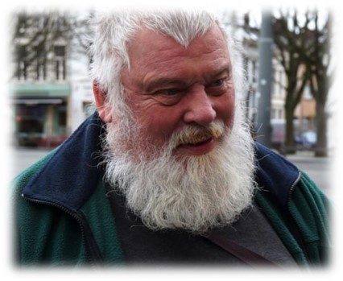
A lecturer and an expert by experience tell about their cooperation
“We were all part of the group. Lecturer, service user and students. All people with their own story, vulnerabilities, but with a lot of similarities.”

Slide 18
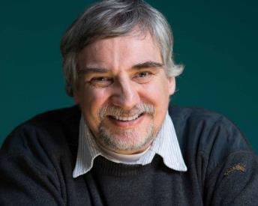
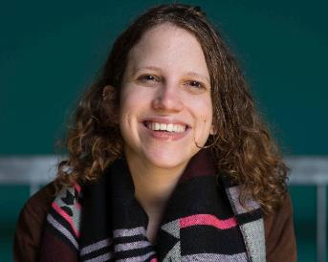
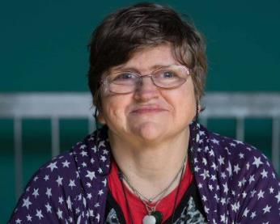
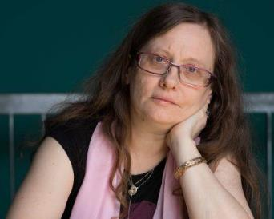
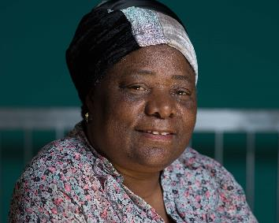
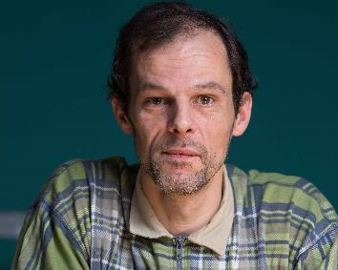
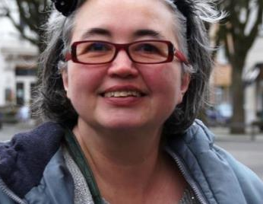
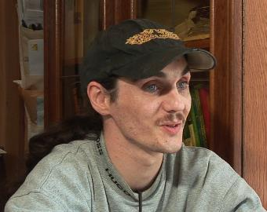
Bind-Kracht coaches join the dialogue

Slide 19
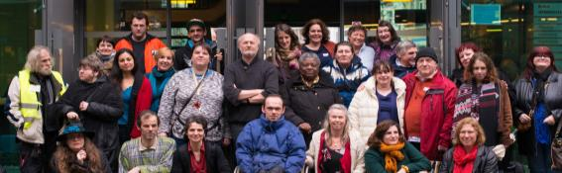
Bind-Kracht, Karel de Grote University College
Brusselstraat 45, 2018 Antwerp, Belgium T 0032 3 613 18 18 www.bindkracht.be coordinator kristel.driessens@kdg.be researcher in ESF-project: Vicky.lyssens-danneboom@kdg.be
Lecturer of KdG (social work): Wendy.peeters@kdg.be
Driessens, K., McLaughlin, H. & van Doorn, L. (2016). The Meaningful Involvement of Service Users in Social Work Education: Examples from Belgium and The Netherlands, Social Work Education, 35(7): 739-751.

Slide 20
Search for inspiring practices

Slide 21
Good practices criteria:
It has been existing for at least two academic years
It can be made sustainable
It focuses on the inclusion of socially vulnerable groups (such as people living in poverty, (former) homeless people, psychiatric patients, ...)
It provides opportunities for vision widening, mutual learning and respectful cooperation through dialogue and partnership
Resulting in:
  Reduction of prejudice
  Acknowledgement of the importance of the client’s perspective in social work
  Collective knowledge production

Slide 22
Call for abstracts
If your model meets the abovementioned criteria
If you wish to take part in this research project
Please submit an abstract containing a description of your model of cooperation
(objective of project / background of service users / nature of cooperation)
- Before the end of July 2017
- To Vicky.Lyssens-Danneboom@kdg.be and Arne.Kristiansen@soch.lu.se

Slide 23

Bind-Kracht, Karel de Grote University College - www.bindkracht.be
Kristel.Driessens@kdg.be en Vicky.Lyssens-Danneboom@kdg.be
Mobilisation Course and PowerUs– University of Lund
Cecilia.Heule@soch.lu.se en Arne.Kristiansen@soch.lu.se

